Slide 1


Neural Network-based Hardware Implementation for Object Detection in Autonomous Driving
Supervised by:
Dr. Khaled Salah
Dr. Mohamed Desoukky
Done by:
1-Ramy Osama
2-Ahmed Yahia
3-Zyad Mahmoud
4-Rofida Osama
5-Omar Khaled

Slide 2
Agenda:
Introduction
Problem statement
Related work
Contribution
Methodology
Implementation
Future work

Slide 3
Introduction

Slide 4
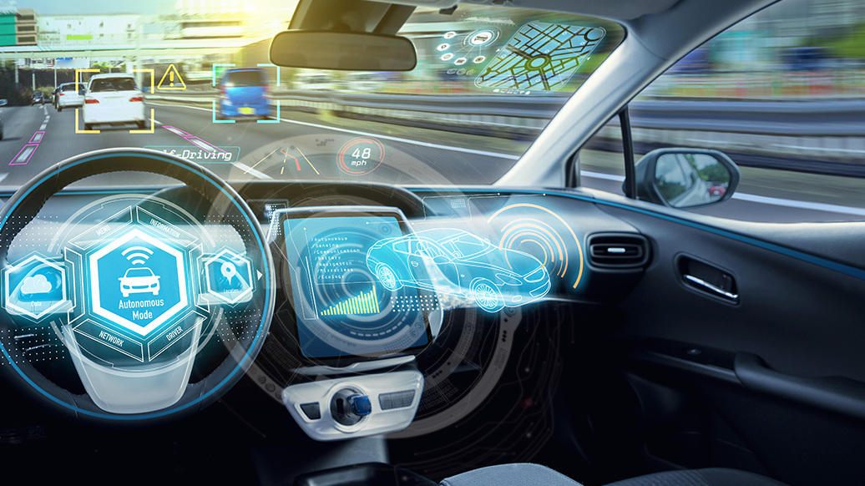
Introduction: Autonomous Car
Self-Driving car is a vehicle that is capable of sensing its environment and moving safely with little or no human input.
Accidents rate could be decreased by 90% after autonomous vehicles are in the streets.

Slide 5
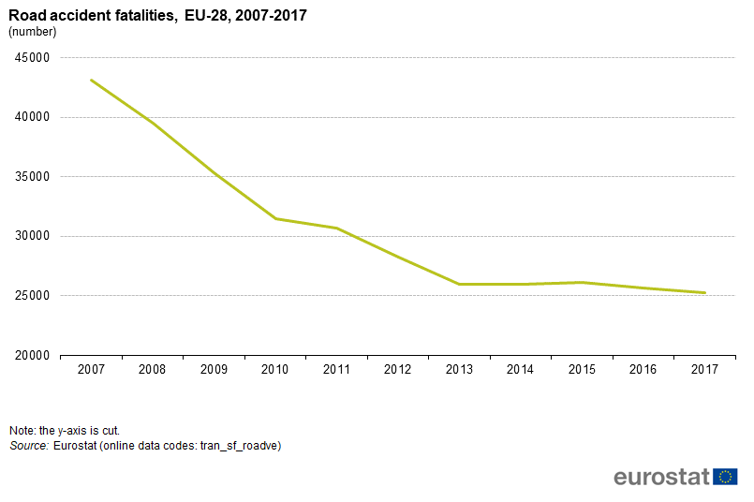

Slide 6
Introduction: Levels of automation
Level 0 – No automation
Level 1 – Driver assistance
Level 2 – Partial automation
Level 3 – Conditional automation
Level 4 – High automation
Level 5 – Full automation

Slide 7
Introduction: Autonomous Vehicle System
Autonomous Vehicle Software
Perception
Planning
Control
Autonomous Vehicle Hardware
Cameras
Lidar
Radar
Sensors

Slide 8
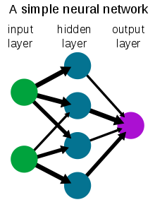
Introduction: Neural Networks
A neural network is a network or circuit of neurons, or in a modern sense, an artificial neural network, composed of artificial neurons or nodes. Thus, a neural network is either a biological neural network, made up of real biological neurons, or an artificial neural network, for solving artificial intelligence (AI) problems.

Slide 9
Problem statement

Slide 10
Why do we need neural networks in the project?
We will use a dataset of common objects we see normally in our daily life in streets to train our neural network to be able to recognise these objects in any future image that would be our input to the neural network.
Examples:
Cars
Human bodies
Cats
Dogs
Buses
Traffic posts

Slide 11
Related work

Slide 12
Convolutional neural network for object detection
Yolo
SSD
RCNN
Fast-RCNN
Faster –RCNN

Slide 13
Contribution

Slide 14
Phases of The Project
1st phase is to find a suitable architecture of a neural network that would be able to satisfy our constrains (delay, complexity, etc..) and implement this architecture using python machine learning modules like TensorFlow and PyTorch
2nd phase after simulating our neural network we will get the weights resulted from the simulation (more details on that later) and use it to implement a hardware chip on a FPGA development kit
We finished the Theory needed in the project and we made a small model for a neural network to Detect some objects
We will finish the Faster RCNN architecture and the hardware and its verification next semester as hardware is faster and can be reconfigured

Slide 15
Methodology

Slide 16
Methodology:
Background
How it works
Comparative study
Challenges
Dataset

Slide 17
Methodology:
Background

Slide 18
Neural network training
Supervised Learning
- training data has one feature considered as output - make prediction based on previous data - easier
Unsupervised learning
- Most common ,labels are expensive - Goals to find patterns or discovery - more difficult

Slide 19
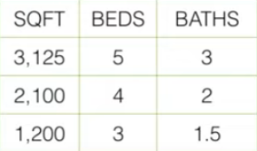

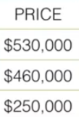
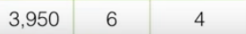

Supervised Learning
Example of data
Ask the neural network

Slide 20
Supervised Learning how to use
r loan next month ? Questions
-How much this home worth?
-Will this customer take loan ?
-How many customers will
apply for loan next month ?
Training data
Previous home sales
Previous loans taken
Previous months of loan applications

Slide 21
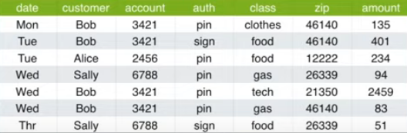
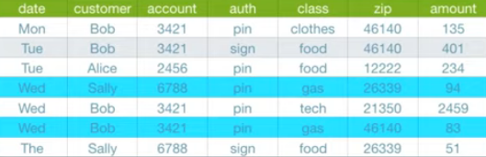
Unsupervised Learning
Example
Clustering

Slide 22
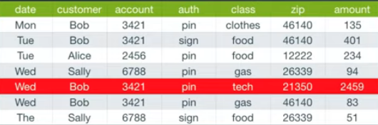
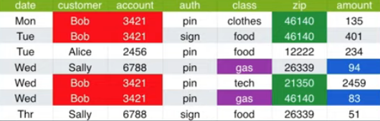
Unsupervised Learning
Anomaly detection
Association discovery

Slide 23
Unsupervised Learning
Questions
Are these customers similar ?
Is this transaction unusual
Are these product purchased together
Training data
Customer profiles
Previous transaction
Previous purchases

Slide 24
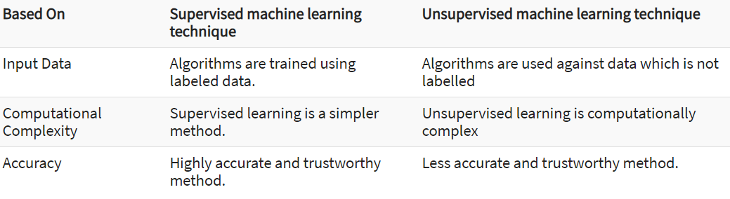
Supervised vs unsupervised learning

Slide 25
What are neural networks types
Recurrent Networks
Symmetrical neural Network
Feed forward Neural network

Slide 26
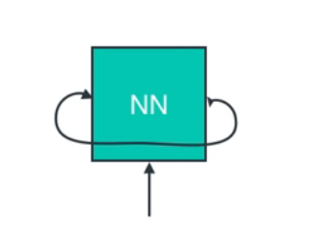
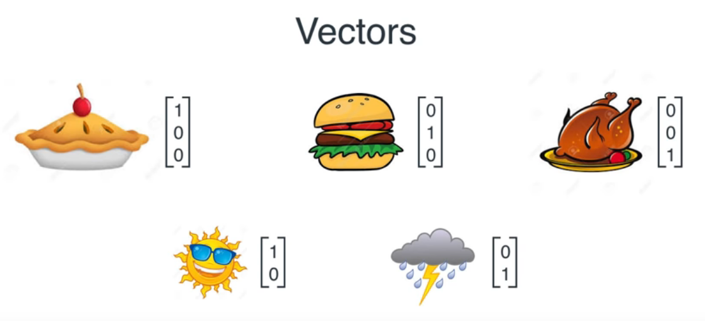
Recurrent Networks
RNNs can use their previous state input you can return to where you started
Feed back methodology -very hard to train
Applications - sound recognition - handwriting recognition

Slide 27
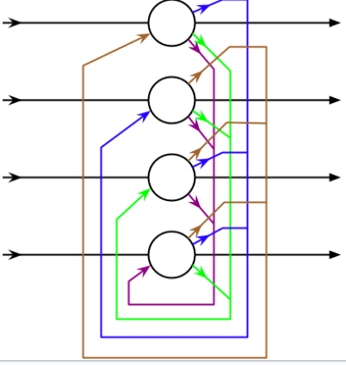
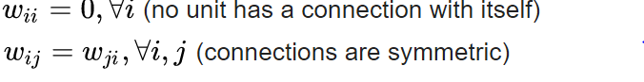
Symmetrically Connected Networks
These are like recurrent networks, but the connections between units are symmetrical
They are also more restricted because of obeying energy functions
Restricted connections used to identify overlapping objects
Two conditions

Slide 28
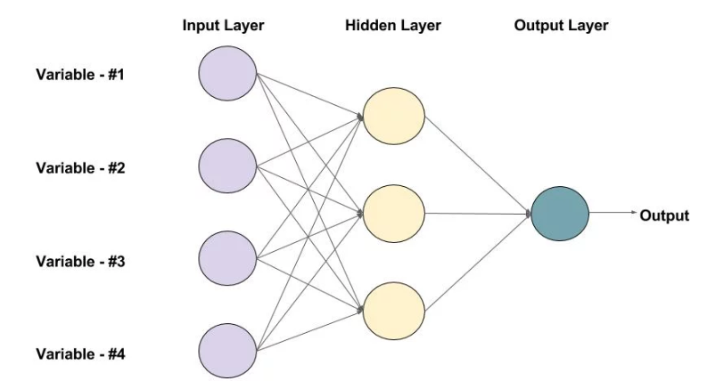
Feed forward Neural network
Data moves in only one direction
No loops or feedback
Faster and much less complex
face recognition and computer vision

Slide 29
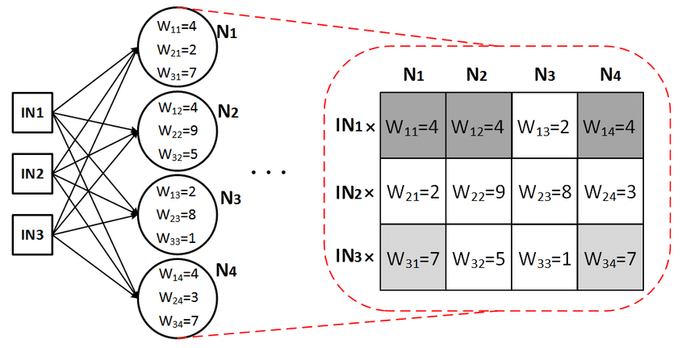
How a neuron operates ?
A neuron is just a mathematical function that takes inputs and returns outputs.
A neuron will take an input vector, and do three things to it:
Multiply it by a weight vector.
Add a bias value to that product.
Apply an activation function to that value.
A Large weight value means important information
( which will affect the final network decision )

Slide 30
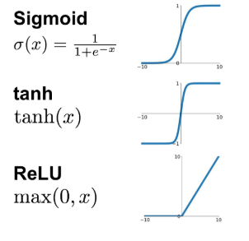
Types of activation functions.
An activation function improves the learning power of the neural network by applying some non-linearity.
Most common types include : sigmoid , RELU, and hyperbolic tangent function.
Problem of sigmoid and hyperbolic tangent function is the vanishing gradient for large input values.
RELU is commonly used as it is six times faster than sigmoid, also no gradient problem.

Slide 31
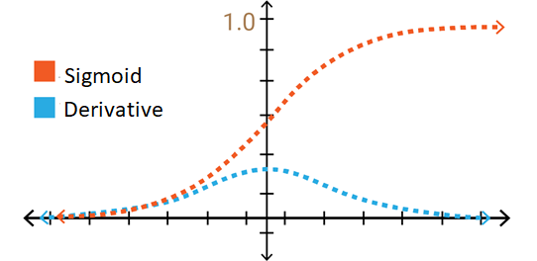
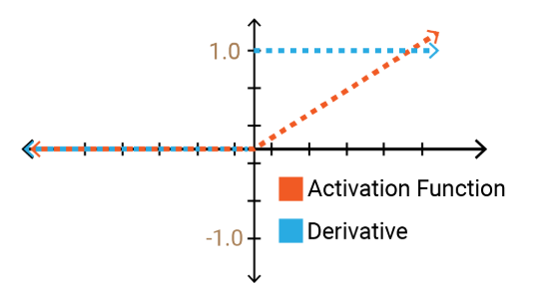
Illustrating two types of activation functions.
Sigmoid.
RELU.

Slide 32
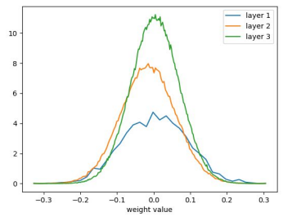
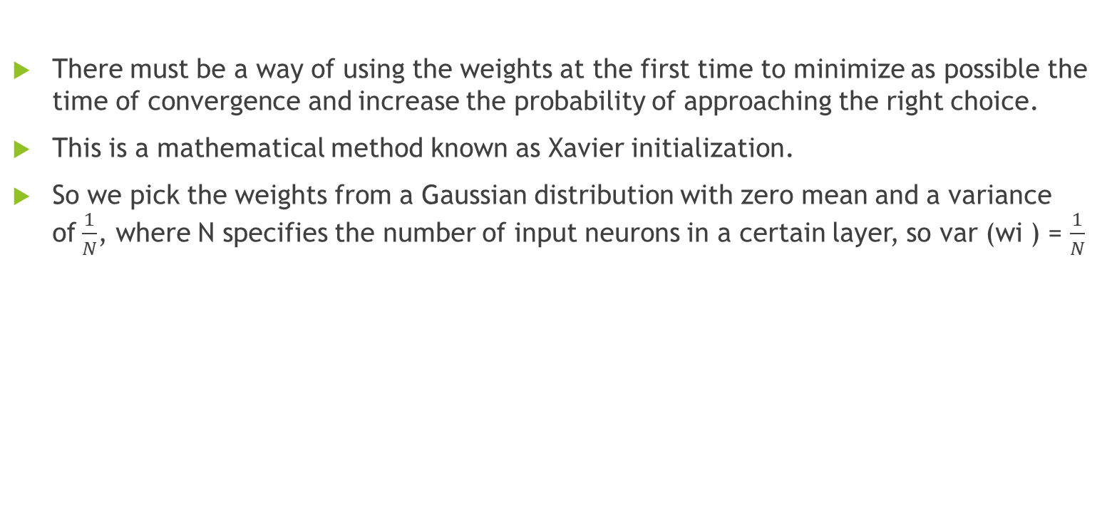
How to initialize the weights at the beginning ?
There must be a way of using the weights at the first time to minimize as possible the time of convergence and increase the probability of approaching the right choice.
This is a mathematical method known as Xavier initialization.
So we pick the weights from a Gaussian distribution with zero mean and a variance of$\frac{1}{N}$, where N specifies the number of input neurons in a certain layer, so var (wi ) = $\frac{1}{N}$

Slide 33
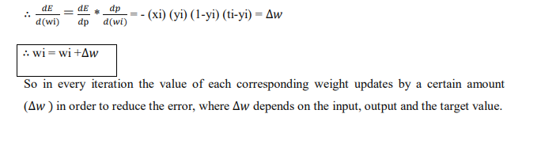
How to update the weights ?
This is usually done by an algorithm known as the backpropagation algorithm.
It is simply a feedback in which the target value , the inputs to the neural network and the outputs from the neural networks are used to update the value of each corresponding weight.
The main target is Minimizing the mean squared error and approach the correct target value.

Slide 34
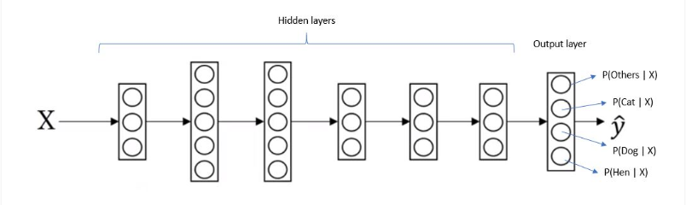
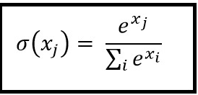
The SoftMax function.
The SoftMax function is used at the final output layer.
The main purpose is mapping the information to a probability distribution.

Slide 35
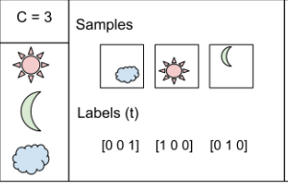
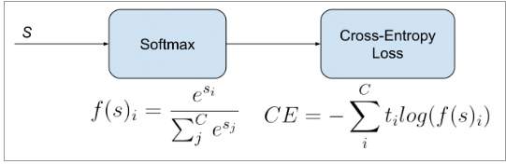
Loss functions and their types.
Loss function helps in optimizing the parameters of the neural networks. Our objective is to minimize the loss for a neural network by optimizing its parameters (weights), very important in training our neural network.
Types include : binary cross entropy and categorical cross entropy.
E.g. the SoftMax output is [0.2,0.2,0.6].

Slide 36
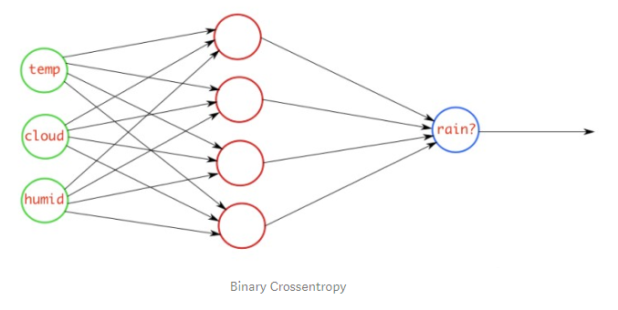
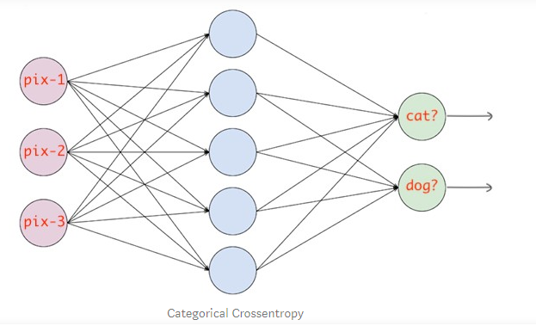
Comparison between two types of loss functions.
Categorical cross entropy.
Binary cross entropy.

Slide 37
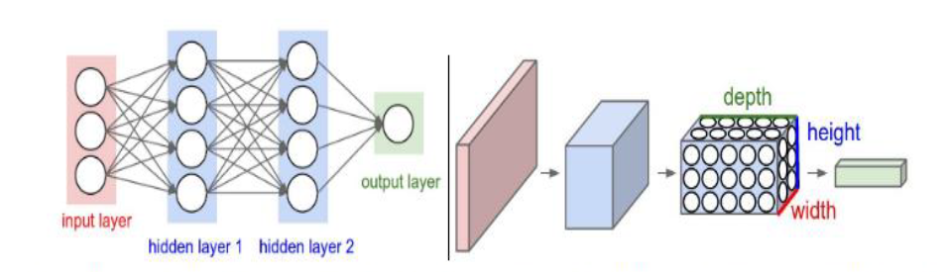
What is CNN and why using it?
very similar to ordinary Neural Networks they are made up of neurons that have learnable weights and biases.
take advantage of the fact that the input consists of images and constrain the architecture in a more sensible way.

Slide 38
Layers of CNN
Convolution
Pooling
Fully connected

Slide 39
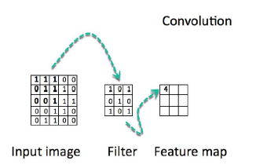
Convolution layer
to extract the features of the locally.
Filter with small height and width but same depth is convolved across the image and a dot product is computed to give an activation map.
Different filters which detect different features are convolved on the input file and a set of activation maps is outputted and passed to the next layer.

Slide 40
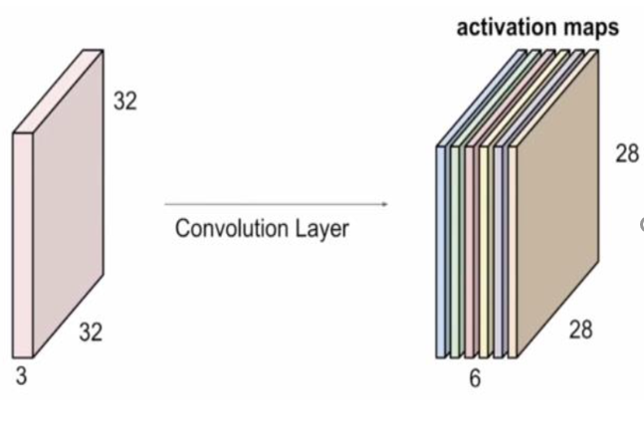
Output of the convolution layer
The size of the output volume for the next layer is controlled by three hyperparameters :
depth ,Stride and Zero padding

Slide 41
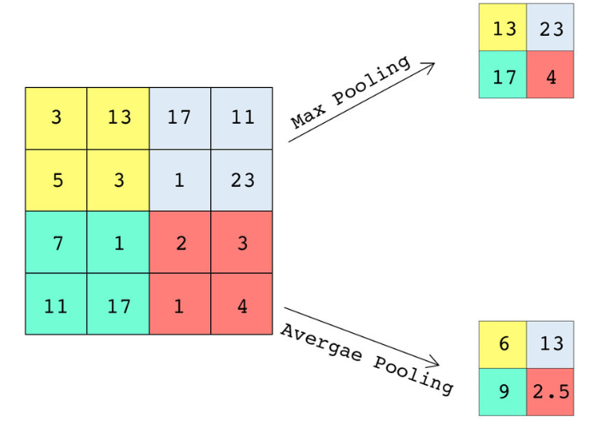
Pooling layer
for reducing the spatial size of the representation
Two types including : max pool and average pool.

Slide 42
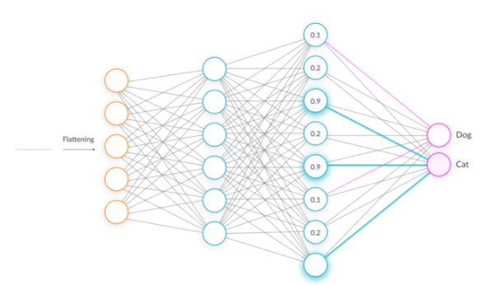
Fully connected layer
connect all neurons from the previous layer to the next layer and use a SoftMax activation function to classify the number on the input image

Slide 43
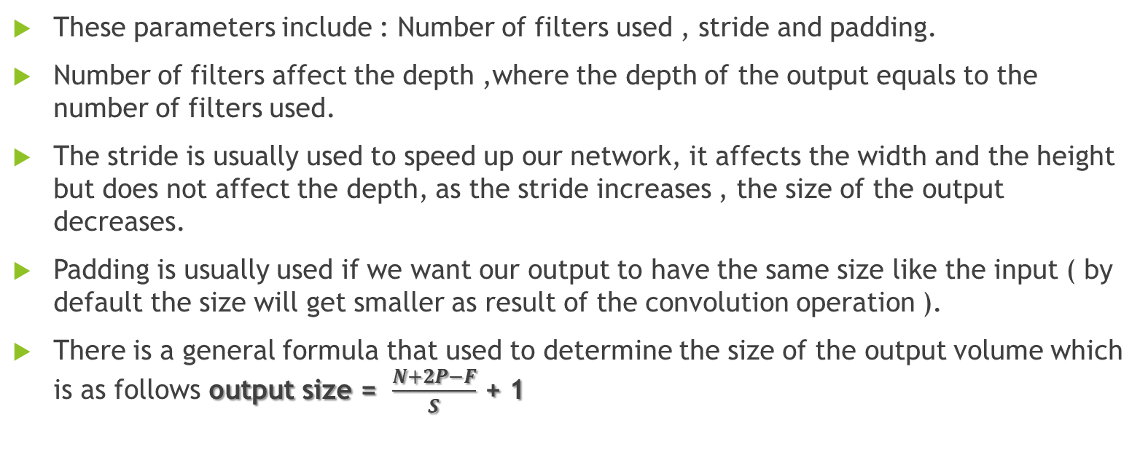
Parameters that affect the Output volume size in a CNN.
These parameters include : Number of filters used , stride and padding.
Number of filters affect the depth ,where the depth of the output equals to the number of filters used.
The stride is usually used to speed up our network, it affects the width and the height but does not affect the depth, as the stride increases , the size of the output decreases.
Padding is usually used if we want our output to have the same size like the input ( by default the size will get smaller as result of the convolution operation ).
There is a general formula that used to determine the size of the output volume which is as follows output size = $\frac{N+2P−F}{S}$ + 1

Slide 44
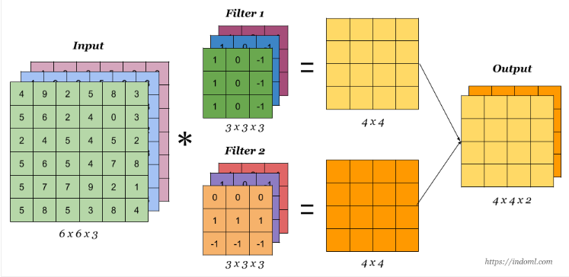
Effect of the number of filters.
We notice that the output size is 4x4x2 , the depth equals 2 because 2 filters are used, generally speaking the filters are used to detect some features like vertical or horizontal edges.

Slide 45
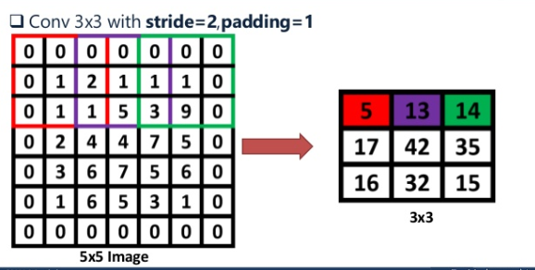
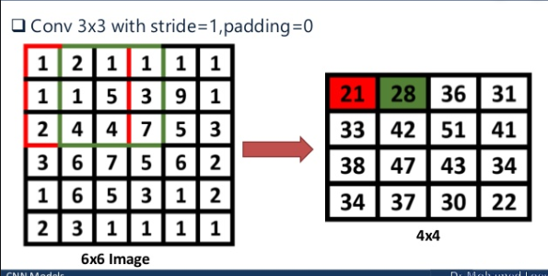
Effect of the stride.
We notice that increasing the stride decreases the processing time and the size but at the same time it might affect the accuracy of the output ( Tradeoff ).

Slide 46
Methodology:
How it works

Slide 47
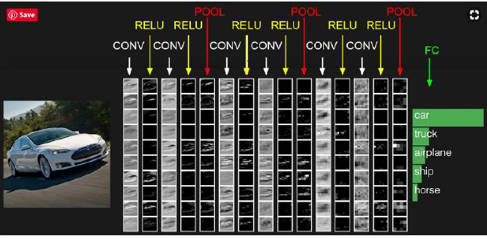

Slide 48
Methodology:
Comparative study

Slide 49
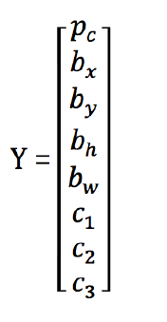
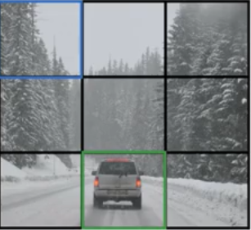
YOLO (you only look once )
The idea is to divide the image into multiple grids.
Anchor boxes
IOU to determine center of object with threshold

Slide 50
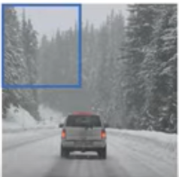
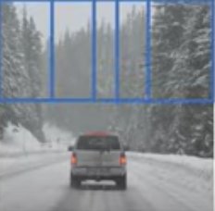
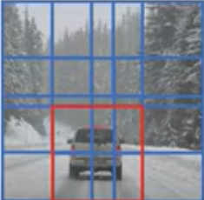
YOLO (you only look once )
sliding window implementation
One look
Share computation
Shortcomings
- only look once much low accuracy - Small objects can't be detected - suffers at generalizing the objects (if dimension changes it can't classify it )

Slide 51
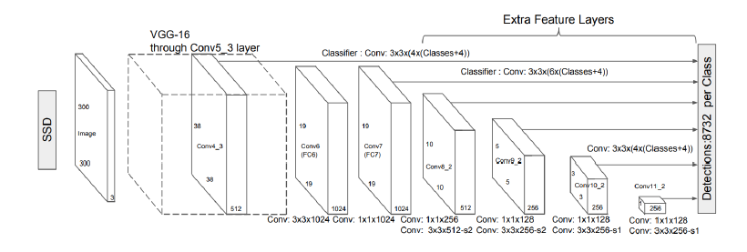
SSD (single shot Detector )
One shot and share many things with yolo
Many anchor boxes with different feature maps
6 aspect ratios allowed
Slower than yolo
- not suitable for real time application -

Slide 52
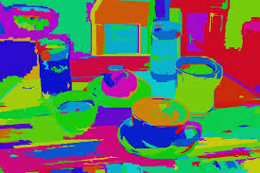
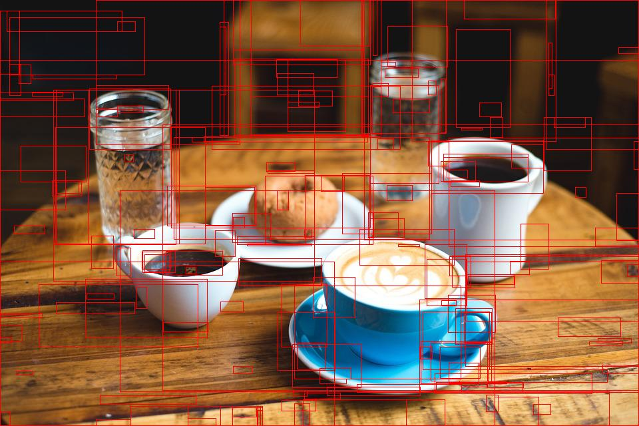
R-CNN
RCNN uses selective search to extract these boxes from an image
Selective Search is a region proposal algorithm based on computing hierarchical grouping of similar regions based on color, texture, size and shape compatibility
After getting the regions, we train SVM to classify objects and background. For each class, we train one binary SVM

Slide 53
Problems with RCNN
Extracting 2,000 regions for each image based on selective search
Extracting features using CNN for every image region. Suppose we have N images, then the number of CNN features will be N*2,000
It takes around 40-50 seconds to make predictions for each new image, which essentially makes the model too slow

Slide 54
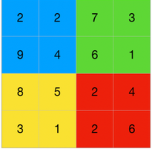
Fast RCNN
In Fast RCNN, we feed the input image to the CNN, which in turn generates the convolutional feature maps. Using these maps, the regions of proposals are extracted
The feature map is the output of one filter applied to the previous layer. A given filter is drawn across the entire previous layer, moved one pixel at a time
A softmax layer is used on top of the fully connected network to output classes. Along with the softmax layer.
But still not the best.

Slide 55
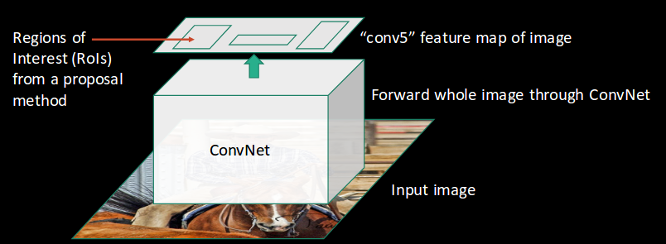

Slide 56
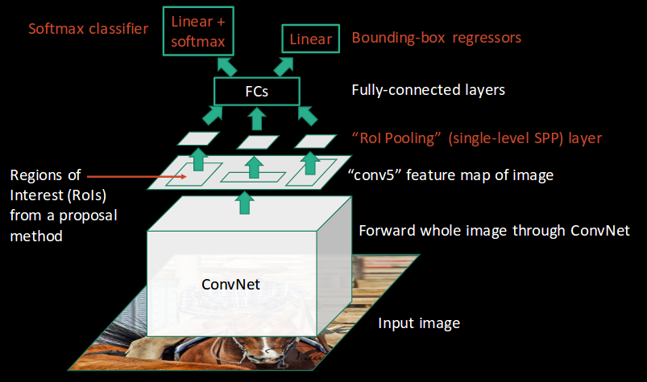

Slide 57


Slide 58
FASTER R-CNN
To begin with, Faster RCNN takes the feature maps from CNN and passes them on to the Region Proposal Network. RPN uses a sliding window over these feature maps, and at each window, it generates k Anchor boxes of different shapes and sizes:
Anchor boxes are fixed sized boundary boxes that are placed throughout the image and have different shapes and sizes. For each anchor, RPN predicts two things.
The first is the probability that an anchor is an object (it does not consider which class the object belongs to)
Second is the bounding box regressor for adjusting the anchors to better fit the object

Slide 59



Slide 60


COMPARISON

Slide 61
Methodology:
Challenges

Slide 62

Overfitting and underfitting in Neural Networks
General Concept :

Slide 63
Basic terms to learn the difference
Training set
Training error
Validation set
Validation error
Test set
Test error

Slide 64



Bias
Variance

Slide 65

Underfitting and how to avoid it
High bias and low variance .

Slide 66

Underfitting and how to avoid it
To solve
Increase complexity (number of input images , number of hidden layers ..etc.
Reduce dropouts
cross-validation.

Slide 67

Overfitting and how to solve it
Low bias and high variance

Slide 68

Overfitting and how to solve it
Add more data
Data augmentation

Slide 69

Overfitting and how to solve it
Dropout: Deactivates neurons randomly

Slide 70

Overfitting and how to solve it
Early stopping: a type of cross validation strategy.

Slide 71
Methodology:
Dataset

Slide 72




Example of used dataset (“Berkeley Deep Drive BDD100k” ):

Slide 73
Implementation

Slide 74

Simulating a neural network
Objective:
Try to classify some fashion objects correctly using a neural network simulated by TensorFlow library:

Slide 75
Layers used:
model = keras.Sequential([
keras.layers.Flatten(input_shape=(28, 28)), # flatten the input to be a list
# dense means a fully connected layer which is our hidden layer here relu is fast
keras.layers.Dense(128, "relu"),
keras.layers.Dense(64, "relu"),
keras.layers.Dropout(0.25),
# this is our output layer and each one of them represent what item is it ,softmax is used so that all the
# neurons in this layer add up to 1 making it a probability
keras.layers.Dense(10, "softmax")
])

Slide 76
Algorithms used
model.compile(optimizer="adam", loss="sparse_categorical_crossentropy", metrics=["accuracy"])
# this is used to train our network check what epochs is in the copybook
model.fit(train_images, train_labels, epochs=100)
# now its time to check how our network works so we will see the accuracy
test_loss, test_acc = model.evaluate(test_images, test_labels)
print("our accuracy is ", test_acc)

Slide 77
Results
Layers | Accuracy after training | Accuracy of test data | Number of epochs | Simulation time/min | Dropout
1 Hidden layer of 128 neurons | 87% | 86% | 5 | 1.5 | 0
1 Hidden layer of 128 neurons | 90% | 88% | 10 | 3 | 0
1 Hidden layer of 128 neurons | 98% | 90% | 100 | 15 | 0.25
2 hidden layers of sizes 128 and 64 | 86% | 85% | 5 | 2 | 0
2 hidden layers of sizes 128 and 64 | 89% | 87% | 10 | 5 | 0
2 hidden layers of sizes 128 and 64 | 97% | 89.5% | 100 | 20 | 0.25

Slide 78



Results:

Slide 79
Future work

Slide 80
Future work
Tools to be learnt:
We need a HDL language to do our chip so we chose Verilog as it is the most widely used language in the market today
Questa® Advanced Simulator
Xlinx which is a third-party ecosystem provide software development environments and embedded platforms that offer a comprehensive set of familiar and powerful tools, libraries, and methodologies. These environments lower your development time while allowing you to create custom hardware accelerators easily and on-demand.

Slide 81

Implementation of faster RCNN based neural network:
Future work

Slide 82

Start the implementation of the chip using the Questa and Xlinx tool

Slide 83
Any Questions?

Slide 84
Thank You

